Slide 1
COMP4901K/Math4824B Machine Learning for Natural Language Processing
Lecture 20: Word Embeddings
Instructor: Yangqiu Song
Slides credits: Richard Socher, Vagelis Hristidis

Slide 2


Cross Entropy Loss
In binary classification, where the number of classes M equals 2, cross-entropy can be calculated as:
If M>2 (i.e. multiclass classification), we calculate a separate loss for each class label per observation and sum the result.
Remember the output of softmax function

Slide 3
Example
Classification accuracy = 2/3
Cross-entropy loss = 4.14
Classification accuracy = 2/3
Cross-entropy loss = 1.92
why-you-should-use-cross-entropy-error

Slide 4
Semantic Similarity/Relatedness
Similarity is a specific type of relatedness: graded
car vs. automobile -> 1.0
car vs. vehicle -> 0.6
car vs. tire -> 0.2
car vs. street -> 0.1
Similarity: synonyms, hyponyms/hyperonyms, and siblings are highly similar
doctor vs. surgeon, bike vs. bicycle
Relatedness: topically related or based on any other semantic relation
heart vs. surgeon, tire vs. car

Slide 5
Computational Approaches
Knowledge base based
WordNet Similarity
…
Corpus based
Distributional similarity
Deep learning

Slide 6
Corpus based Approach
Roots in linguistics:
Distributional hypothesis: Semantically similar words occur in similar contexts (Harris (1954))
You shall know a word by the company it keeps." (Firth (1957))
Distributional semantics
The distributional hypothesis in linguistics is derived from the semantic theory of language usage, i.e. words that are used and occur in the same contexts tend to purport similar meanings.
The basic idea of distributional semantics can be summed up in the so-called Distributional hypothesis: linguistic items with similar distributions have similar meanings.
We will mention distributed representation based neural language models in this class

Slide 7
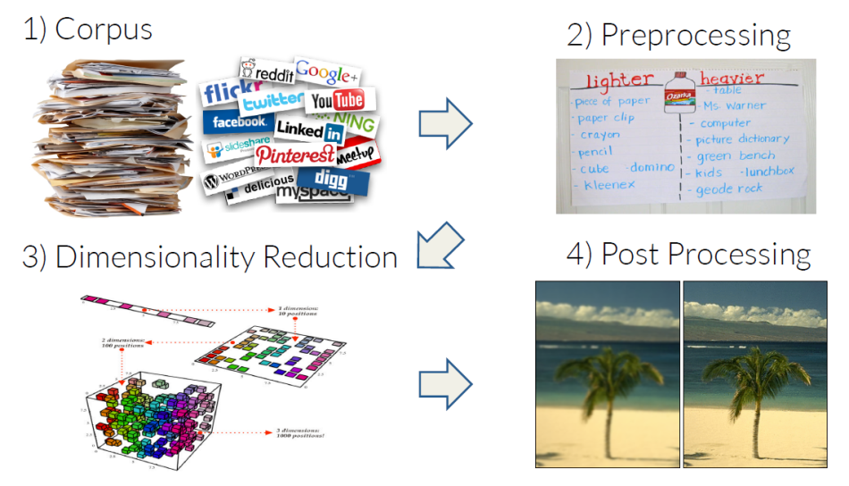
Corpus based Approach

Slide 8
Let's try to keep the kitchen .
Observation: context can tell us a lot about word meaning
Context: local window around a word occurrence (for now)
Roots in linguistics:
Distributional hypothesis: Semantically similar words occur in similar contexts [Harris, 1954]
"You shall know a word by the company it keeps." [Firth, 1957]
Pros: data-driven, easy to implement
Cons: ambiguity

Slide 9
Window based co-occurrence matrix
Window length 1 (more common: 5 - 10)
Symmetric (irrelevant whether left or right context)
Example corpus:
I like deep learning.
I like NLP.
I enjoy flying.

Slide 10
Window based co-occurrence matrix
Example corpus:
I like deep learning.
I like NLP.
I enjoy flying.
If the vectors are too sparse —— so many zeros in vector representation, you may get zero similarity.

Slide 11
Problems with simple co-occurrence vectors
Increase in size with vocabulary
Very high dimensional: require a lot of storage
Subsequent classification models have sparsity issues
→Models are less robust

Slide 12
Solution: Low dimensional vectors
Idea: store “most” of the important information in a fixed, small number of dimensions: a dense vector
- group similar words into one feature. (convert multiple entries into a single entry.)
Usually around 25 – 1000 dimensions
How to reduce the dimensionality?

Slide 13
Method 1: Dimensionality Reduction on X
Singular Value Decomposition of co-occurrence matrix X.
best rank k approximation to X , in terms of least squares.

Slide 14
Simple SVD word vectors in Python
Corpus:
I like deep learning. I like NLP. I enjoy flying.

Slide 15
Simple SVD word vectors in Python
Corpus: I like deep learning. I like NLP. I enjoy flying.
Printing first two columns of U corresponding to the 2 biggest singular values

Slide 16
Word meaning is defined in terms of vectors
In most deep learning models, a word is represented as a dense vector

Slide 17
Hacks to X
Problem: function words (the, he, has) are too frequent → syntax has too much impact. Some fixes:
min(X,t), with t~100
Ignore them all
Ramped windows that count closer words more
Use Pearson correlations instead of counts, then set negative values to 0

Slide 18
Interesting semantic patters emerge in the vectors
An Improved Model of Semantic Similarity Based on Lexical Co-Occurrence (Rohde et al. 2005)

Slide 19
Interesting semantic patters emerge in the vectors
An Improved Model of Semantic Similarity Based on Lexical Co-Occurrence (Rohde et al. 2005)

Slide 20
Interesting semantic patters emerge in the vectors
An Improved Model of Semantic Similarity Based on Lexical Co-Occurrence (Rohde et al. 2005)

Slide 21
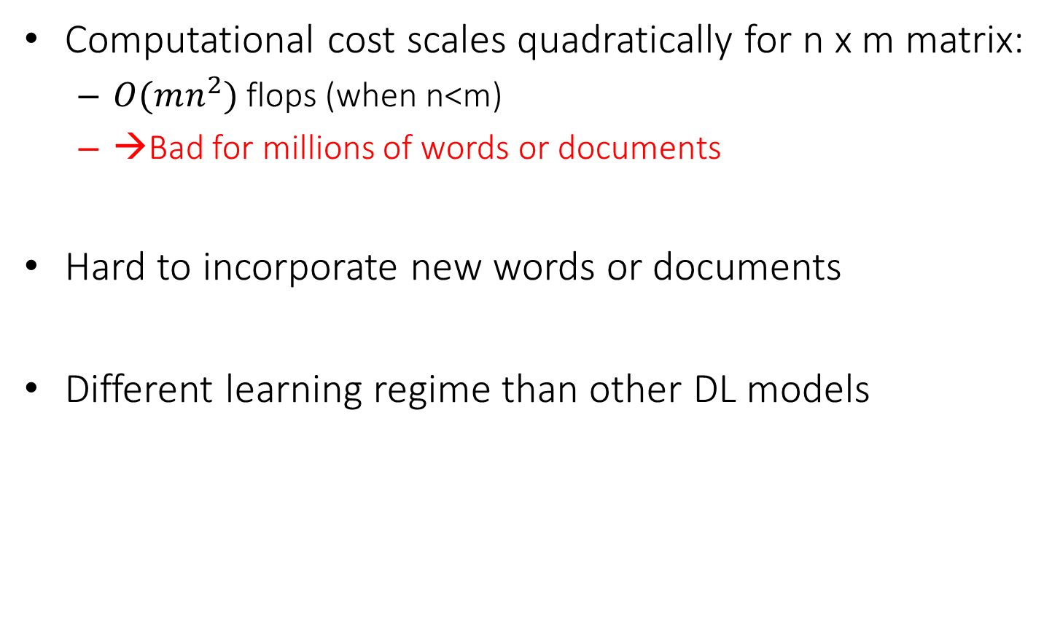
Problems with SVD
Computational cost scales quadratically for n x m matrix:
$O(mn^{2})$ flops (when n<m)
→Bad for millions of words or documents
Hard to incorporate new words or documents
Different learning regime than other DL models

Slide 22
Idea: Directly learn low-dimensional word vectors
Old idea. Relevant for this lecture & deep learning:
Learning representations by back-propagating errors. (Rumelhart et al., 1986)
A neural probabilistic language model (Bengio et al., 2003)
Multilayer perceptron
NLP (almost) from Scratch (Collobert & Weston, 2008)
CNN
An even simpler and faster model:
word2vec (Mikolov et al. 2013) → intro now

Slide 23
Distributed Representations
This is usually called distributed representations in the context of deep learning
Vector representation does not represent a distribution, but distributed over the space
Term widely used in connectionism (Learning distributed representations of concepts, Hinton (1986))
“In the componential approach each concept is simply a set of features and so a neural net can be made to implement a set of concepts by assigning a unit to each feature and setting the strengths of the connections between units so that each concept corresponds to a stable pattern of activity distributed over the whole network.”
Compared to distributional semantics
The distributional hypothesis in linguistics is derived from the semantic theory of language usage, i.e. words that are used and occur in the same contexts tend to purport similar meanings.

Slide 24
Main Idea of word2vec
Instead of capturing co-occurrence counts directly,
Predict surrounding words of every word
Both are quite similar, see “Glove: Global Vectors for Word Representation” by Pennington et al. (2014) and Levy and Goldberg (2014) … more later
Faster and can easily incorporate a new sentence/document or add a word to the vocabulary

Slide 25
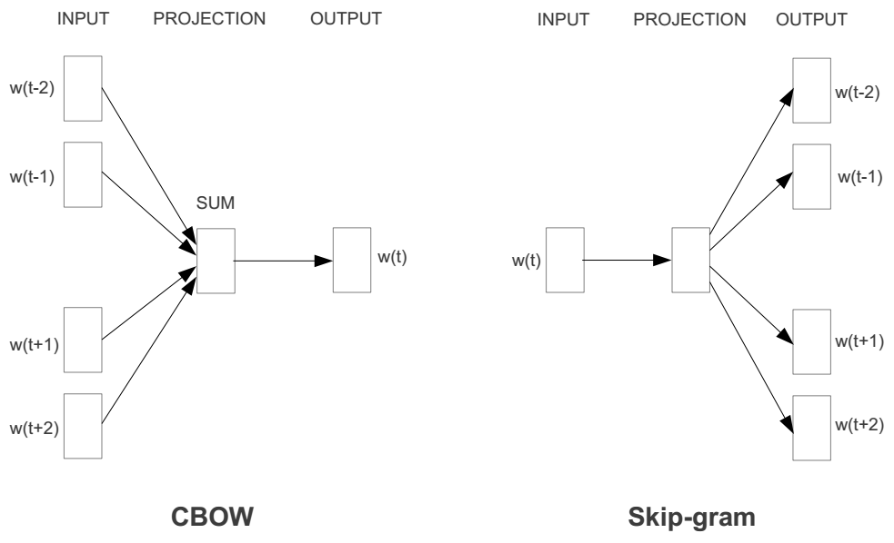
Represent the meaning of word – word2vec
2 basic neural network models:
Continuous Bag of Word (CBOW): use a window of word to predict the middle word
Skip-gram (SG): use a word to predict the surrounding ones in window.

Slide 26
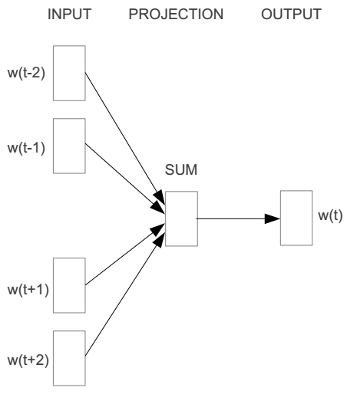
Word2vec – Continuous Bag of Word
E.g. “The cat sat on floor”
Window size = 2
the
cat
sat
on
floor

Slide 27
Input layer
Index of cat in vocabulary
0
1
0
cat
0
Hidden layer
Output layer
0
0
0
0
0
0
…
0
0
0
one-hot
vector
0
sat
one-hot
vector
0
0
0
0
1
0
…
1
0
on
0
0
0
0
…
0

Slide 28



We must learn W and W’
Input layer
0
1
0
cat
0
$$W_{V×N}$$
Hidden layer
Output layer
0
0
0
0
0
0
V-dim
…
0
0
$${W′}_{N×V}$$
0
0
sat
0
0
0
0
1
0
$$W_{V×N}$$
N-dim
…
V-dim
1
0
on
0
0
0
0
V-dim
…
N will be the size of word vector
0

Slide 29
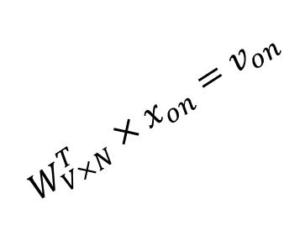

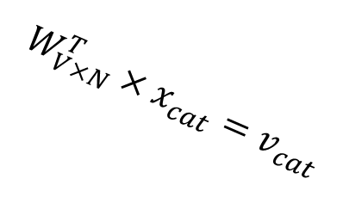



$$W_{V×N}^{T} ×x_{cat}=v_{cat}$$
0.1 | 2.4 | 1.6 | 1.8 | 0.5 | 0.9 | … | … | … | 3.2
0.5 | 2.6 | 1.4 | 2.9 | 1.5 | 3.6 | … | … | … | 6.1
… | … | … | … | … | … | … | … | … | …
… | … | … | … | … | … | … | … | … | …
0.6 | 1.8 | 2.7 | 1.9 | 2.4 | 2.0 | … | … | … | 1.2
0
2.4
2.6
…
…
1.8
Input layer
1
$$×$$
0
$$=$$
0
0
1
0
0
0
x_{cat}
0
0
Output layer
0
0
0
$$W_{V×N}^{T}×x_{cat}=v_{cat}$$
…
0
0
0
0
0
V-dim
…
0
0
$$\hat{v}=\frac{v_{cat}+v_{on}}{2}$$
0
+
0
sat
0
0
0
0
$$W_{V×N}^{T}×x_{on}=v_{on}$$
1
0
…
V-dim
1
Hidden layer
0
x_{on}
0
0
N-dim
0
0
V-dim
…
0

Slide 30

W: 该word的下一个出现各个词的概率
$$W_{V×N}^{T} ×x_{on}=v_{on}$$
0.1 | 2.4 | 1.6 | 1.8 | 0.5 | 0.9 | … | … | … | 3.2
0.5 | 2.6 | 1.4 | 2.9 | 1.5 | 3.6 | … | … | … | 6.1
… | … | … | … | … | … | … | … | … | …
… | … | … | … | … | … | … | … | … | …
0.6 | 1.8 | 2.7 | 1.9 | 2.4 | 2.0 | … | … | … | 1.2
0
1.8
2.9
…
…
1.9
Input layer
0
$$×$$
0
$$=$$
0
1
1
0
0
0
x_{cat}
0
0
Output layer
0
0
0
$$W_{V×N}^{T}×x_{cat}=v_{cat}$$
…
0
0
0
0
0
V-dim
…
0
0
$$\hat{v}=\frac{v_{cat}+v_{on}}{2}$$
0
+
0
sat
0
0
0
0
$$W_{V×N}^{T}×x_{on}=v_{on}$$
1
0
…
V-dim
1
Hidden layer
0
x_{on}
0
0
N-dim
0
0
V-dim
…
0

Slide 31






Input layer
0
1
0
cat
0
$$W_{V×N}$$
Hidden layer
Output layer
0
0
0
0
0
0
V-dim
…
0
0
$$W_{V×N}^{′}×\hat{v}=z$$
0
$$\hat{y}=softmax(z)$$
0
0
0
0
0
$$\hat{v}$$
1
0
$$W_{V×N}$$
…
1
N-dim
0
on
0
${\hat{y}}_{sat}$
0
0
V-dim
0
V-dim
…
N will be the size of word vector
0

Slide 32


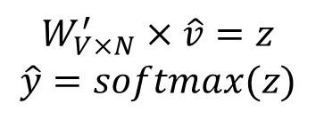
Input layer
0
We would prefer $\hat{y}$ close to ${\hat{y}}_{sat}$
1
0
cat
0
$$W_{V×N}$$
Hidden layer
Output layer
0
0
0
0
0.01
0.02
0.00
0.02
0.01
0.02
0.01
0.7
…
0.00
0
0
V-dim
…
0
0
$$W_{V×N}^{′}×\hat{v}=z$$
$$\hat{y}=softmax(z)$$
0
0
0
0
0
0
$$\hat{v}$$
1
0
$$W_{V×N}$$
…
1
N-dim
0
on
0
${\hat{y}}_{sat}$
0
0
V-dim
0
V-dim
…
N will be the size of word vector
$\hat{y}$
0

Slide 33
Approximations
With large vocabularies this objective function is not scalable and would train too slowly! → Why?
Idea: approximate the normalization or
Define negative prediction that only samples a few words that do not appear in the context
Similar to focusing on mostly positive correlations
More reading
https://canvas.ust.hk/courses/16504/files/1444107?module_item_id=214783

Slide 34
Linear Relationships in word2vec
These representations are very good at encoding dimensions of similarity!
Analogies testing dimensions of similarity can be solved quite well just by doing vector subtraction in the embedding space
Syntactically
apple − apples ≈ car − cars ≈ family − families
Similarly for verb and adjective morphological forms
Semantically (Semeval 2012 task 2)
shirt − clothing ≈ chair − furniture
king − man ≈ queen − woman
The similarity in the sense of the difference between two words.

Slide 35
Word Analogies
Test for linear relationships, examined by Mikolov et al. (2014)

Slide 36
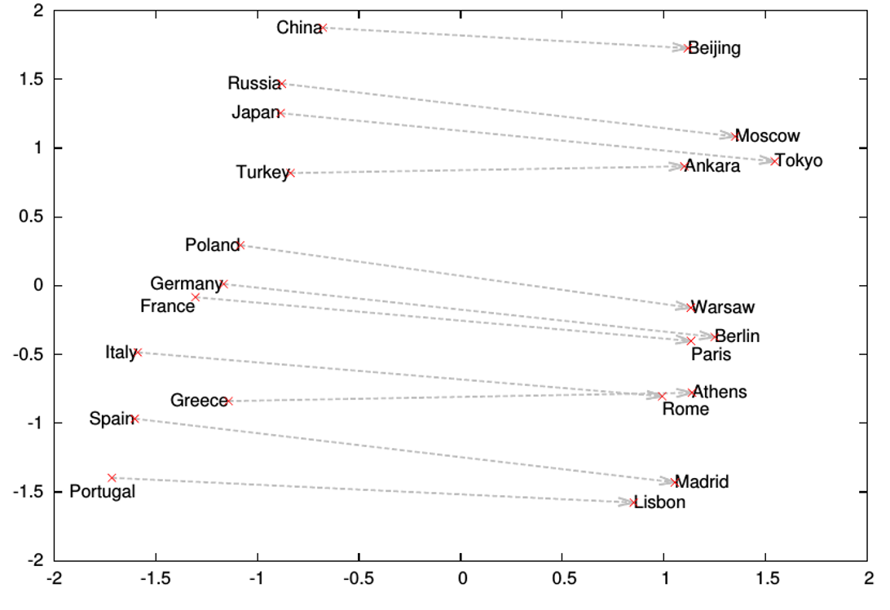
Word analogies

Slide 37
Glove Visualizations

Slide 38
Glove Visualizations: Company - CEO

Slide 39
Glove Visualizations: Superlatives

Slide 40
More Examples
“word2vec Parameter Learning Explained”, Xin Rong
https://ronxin.github.io/wevi/
Word2Vec Tutorial - The Skip-Gram Model
http://mccormickml.com/2016/04/19/word2vec-tutorial-the-skip-gram-model/

Slide 41
Deep Contextualized Word Representation
As most NLP tasks are context related, most of existing methods would contextualize the word embedding before make the final prediction
However, complicated neural models requires extensive training data:
Models pre-trained on the ImageNet are widely used for Computer Vision tasks
What’s the proper way to conduct pre-training for NLP?
Basic Idea
Leveraging Language Modeling to get pre-trained contextualized representation models
Highlight:
1. rely on large corpora, instead of human annotations
2. works very well ---- improve the performance of existing SOA methods a lot
http://aclweb.org/anthology/N18-1202

Slide 42
Experiments
Add ELMo at the input of RNN. For some tasks (SNLI, SQuAD), including ELMo at the output brings further improvements

Slide 43
Google’s BERT
Training of BERT-BASE was performed on 4 Cloud TPUs in Pod configuration (16 TPU chips total).
Training of BERT-LARGE was performed on 16 Cloud TPUs (64 TPU chips total).
Each pre-training took 4 days to complete.
https://ai.googleblog.com/2018/11/open-sourcing-bert-state-of-art-pre.html
https://arxiv.org/pdf/1810.04805.pdf

Slide 44
Experiments

